Slide 1

A Use-case Example: Transients
SI
Demonstration on IEEE 123 bus system
8/14/2023
Oak Ridge National Laboratory

Slide 2
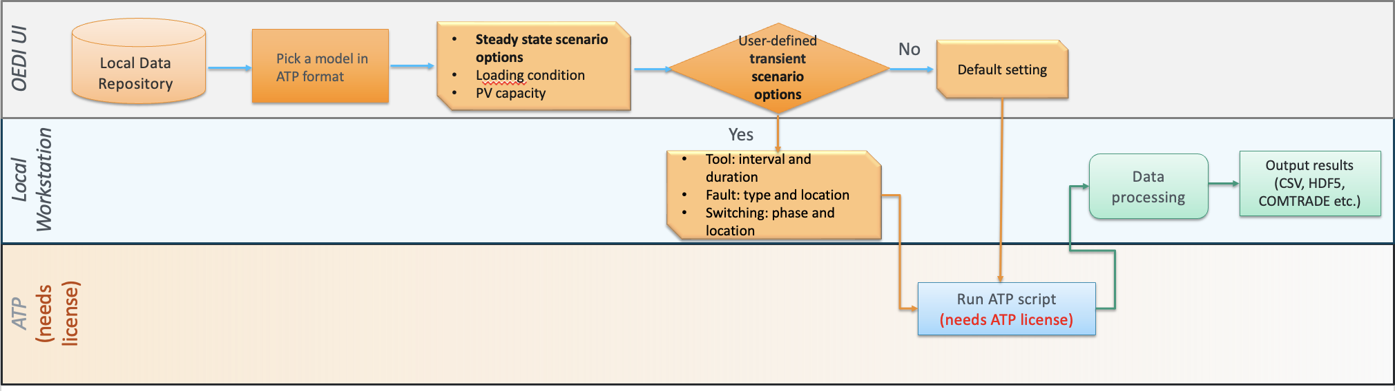
Transient Use-case a. Data Generation
Objective: Development of an open-source transient data library
Providing POW transient data in distribution models under multiple scenarios
Developing algorithms for event detection and classification purpose, based on the datasets in the open-source data library

Slide 3
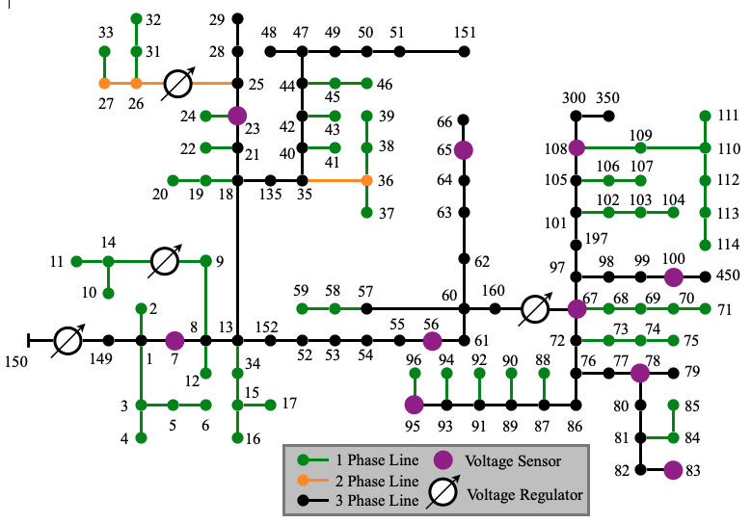
Transient Use-case a. Data Generation
Data generation
1584 fault cases in IEEE 123 bus system
Loading condition: 0.4/1.0
PV capacity: 0.4/0.6/0.8/1.0
Fault location: 3 ADJ + 63 three-phase buses
Fault type: single-phase/line-to-line/three-phase
Sampling rate: 20 kHz; Time window: [0s, 0.6s]
Data preprocessing
Avoid the initialization of simulation cases
Remove [0s, 0.2s] of the data
Topology of IEEE 123 bus system

Slide 4
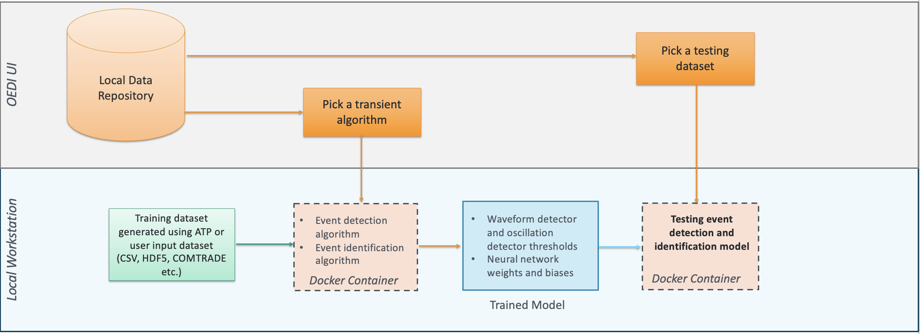
Transient Use-case b. Algorithms
Methodology:
Conducting data generation and preprocessing
Developing waveform-based event detection algorithms
Developing basic machine learning-based event classification algorithms

Slide 5
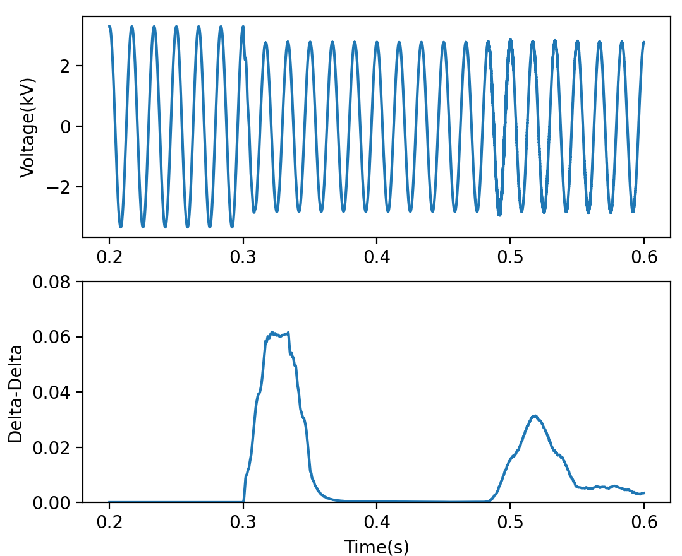
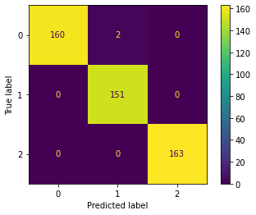

Transient Use-case b. Algorithms
Detection
Event detected?
Yes
Data period with
detected event
POW voltage
Classification
Event type
No
fault
PV trip
Pass
No event detected
5 points after the event. (20 kHz sampling rate)
(a) Raw data
(b) DWT feature extraction
Input Data: POW phase A feeder head voltage of IEEE 123 bus network
Loading condition: 0.4; PV capacity: 0.4
Fault location: ADJ1
Method: Periodic waveform detector
Output: 0 (no event) / 1 (pass data during event period)
Confusion matrix of one ML algorithm (SVM)
Input Data: Detected event data period
1584 fault cases (70% for training; 30% for testing)
Method: Multiple machine learning algorithms
Output: Identified event type as
0 (single-phase) / 1 (line-to-line) / 2 (three-phase)

Slide 6
Transient Demo
Data Processing
Case number: 1584 fault cases in IEEE 123 bus system
Case variation: Loading condition/PV capacity/Fault type/Fault location
Sampling rate: 20kHz
Time window: 0~0.6s (event at 0.3s)
Offline
Data Generation
Data Preprocessing
Remove initialization of the simulation (0~0.2s)
Naïve Bayes/SVM
Define model
Cross validation
Show results
Error, accuracy, time, confusion matrix
Docker Package
Transient analysis algorithm
Event Detection Algorithm
Method: periodic waveform detector
Threshold Selection: 0.012 (a. guarantee no misdetection; b. capture at the same point)
Data store: pre 0.05s and post 0.1s
Event Classification Algorithm
Feature extraction: DWT method
Method: multiple machine learning algorithms
Class: Single-phase/line-to-line/three-phase fault
Online

Slide 7
Transient Demo
1. Open a terminal or command prompt, pull the docker image using the following command:
docker pull liub725/oedi-transient-demo
2. Run the Docker image using the following command which maps port 8888 of the container to the host's port 8888:
docker run -p 8888:8888 liub725/oedi-transient-demo
3. You should see the Jupyter Notebook server starting up. Look for a URL with a token in the terminal output, similar to:
http://127.0.0.1:8888/?token=<TOKEN>
4. Copy the URL and paste it into a web browser. This will open the Jupyter Notebook interface in your browser, where you can access and work with the notebook.
For demonstration, the preprocessed data are saved as csv files and directly loaded in the detection and classification Jupyter notebook examples.

